Slide 1
Node.js/Express.js

Slide 2
Node.js Tutorial
Node.js is an open source server environment.
It allows us to run JavaScript on the server.
A runtime enviroment for executing JavaScript code outside of browser.
It runs on various platforms (Windows, Linux, Unix, Mac OS X, etc.)
Node.js uses asynchronous programming!
It files have extension ".js".

Slide 3
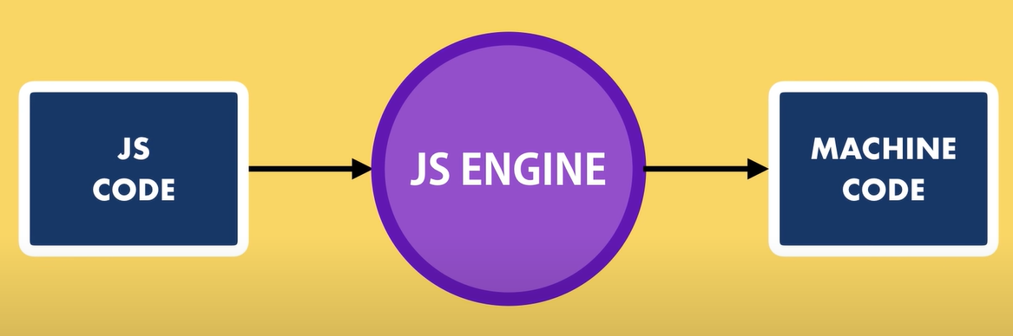
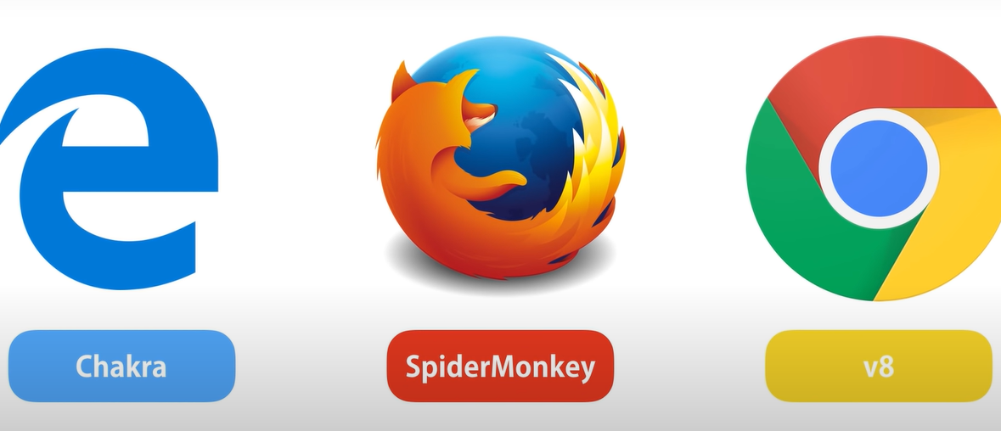
Node Architecture
Every Browser is JavaScript engine.

Slide 4
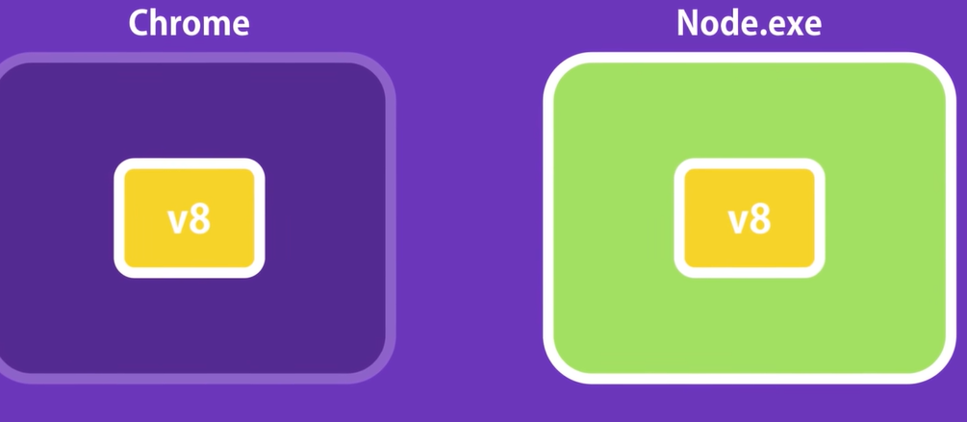
Node Architecture
Combine V8 engine of chrome with C++ programming and run JavasScript outside the browser.
Note: Node is not a programming langauge and not framework. It is runtime enviroment for executing JavaScript Code outside the browser.
Developed by Ryan Dahl in 2009.

Slide 5
Blocking / Synchronous Architecture
A common task for a web server can be to open a file on the server and return the content to the client.
Here is how PHP or ASP handles a file request:
Sends the task to the computer's file system.
Waits while the file system opens and reads the file.
Returns the content to the client.
Ready to handle the next request.

Slide 6
Non-blocking / Asynchronous Architecture
Here is how Node.js handles a file request:
Sends the task to the computer's file system.
Ready to handle the next request.
When the file system has opened and read the file, the server returns the content to the client.
Node.js eliminates the waiting, and simply continues with the next request.
Node.js runs single-threaded, non-blocking, asynchronous programming, which is very memory efficient.

Slide 7
Capabilities of Node.js
Node.js can generate dynamic page content.
Node.js can create, open, read, write, delete, and close files on the server.
Node.js can collect form data.
Node.js can add, delete, modify data in your database.

Slide 8
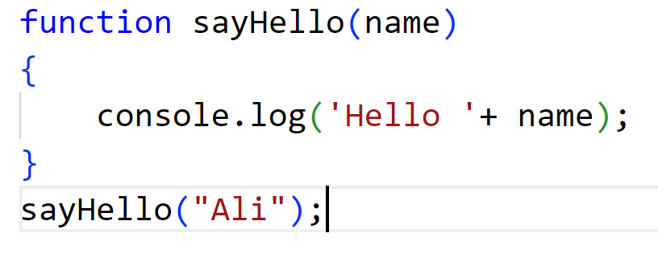
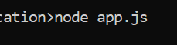
Working with Node.js
Create a dirctory.
mkdir NodeApp
create a file using an editor and save as app.js
Write a function given below and run in cmd node app.js

Slide 9
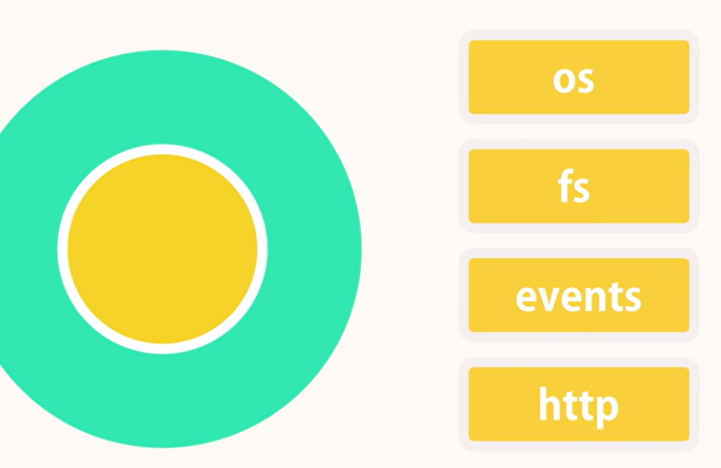
Node Module System
Consider modules to be the same as JavaScript libraries.

Slide 10
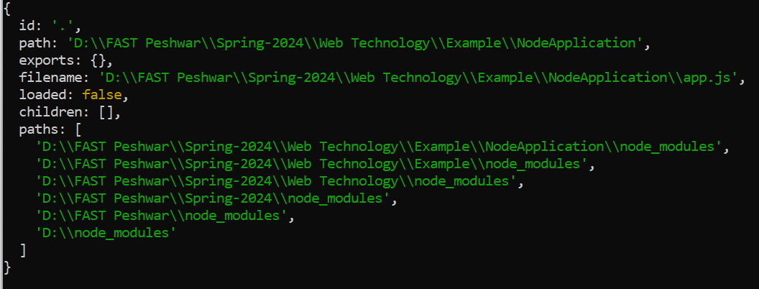
Node Module System
Every node application has atleast one file or one module that is app.js.
Every file is a module, and the functions and variables defined in that module are only accessible within that module.
console.log(module);

Slide 11
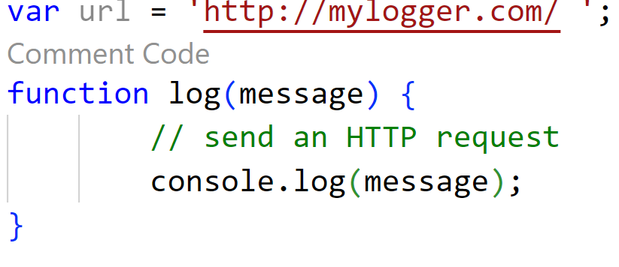
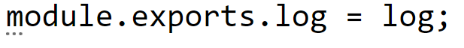
Creating Module
Now add a new module to the existing application.
logger.js
To Make it public. we need to export it.
Use the exports keyword to make properties and methods available outside the module file.

Slide 12
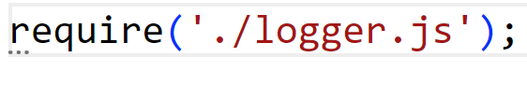
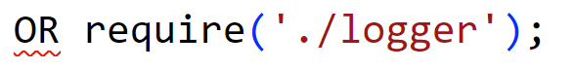
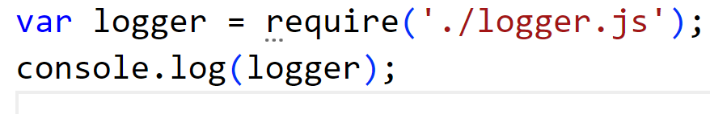
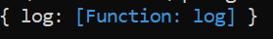
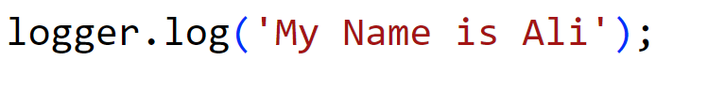
Loading Module
To load module, use require() function. It takes one argument.
Notice that we use ./ to locate the module, that means that the module is located in the same folder as the Node.js file.

Slide 13
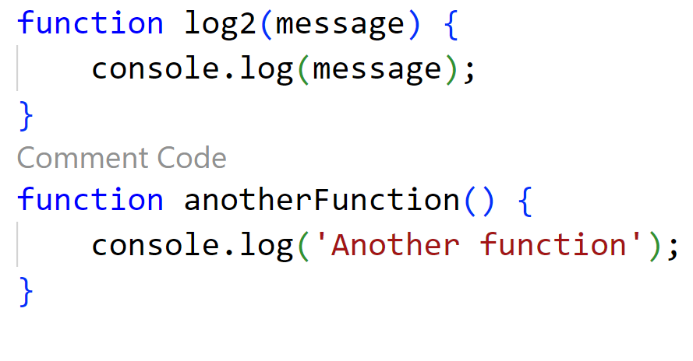
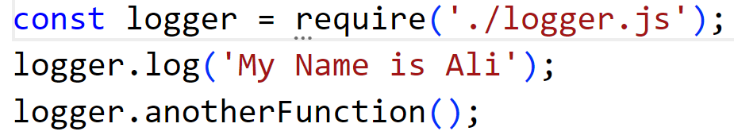
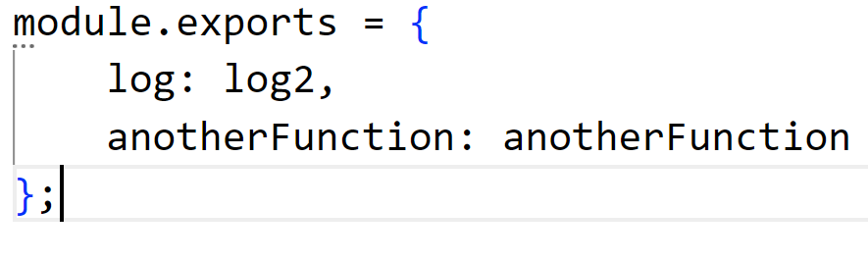
Exporting more than one Modules
Loading in app.js

Slide 14
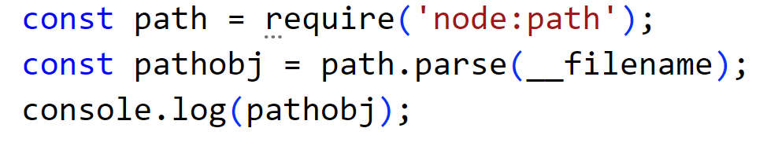
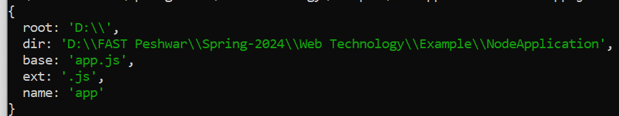
Built-in Modules
Visit https://nodejs.org/ and click on "DOCS"; you will find many useful built-in modules.
Such as HTTP, FileSystem, Path
First we need to call the module using require function.
Example is given below using path module

Slide 15
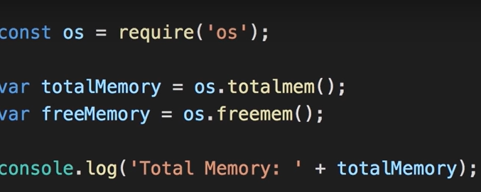
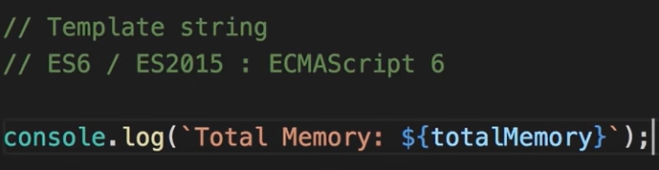
Built-in Modules
OS built-in module Example

Slide 16
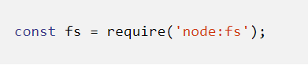
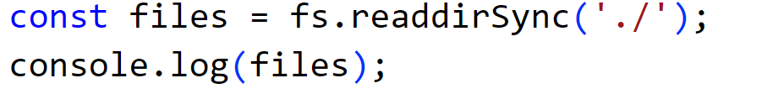
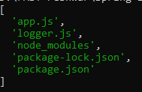
Built-in File System Modules
The above readdirSync is Synchronous call.
It returns array of strings

Slide 17
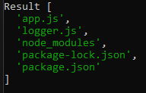
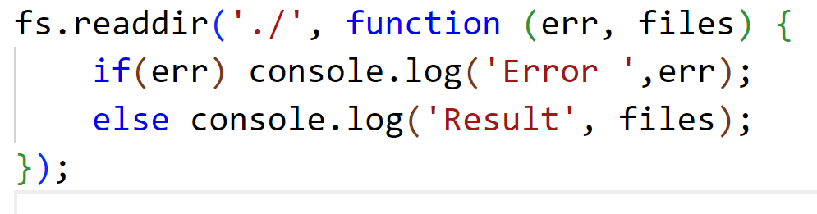
Aysnchronous method calls
All Ansychronous methods will take a function as a last argument.
Node will call this method when the Ayschronous operation is completed.
This function is called callback function.

Slide 18
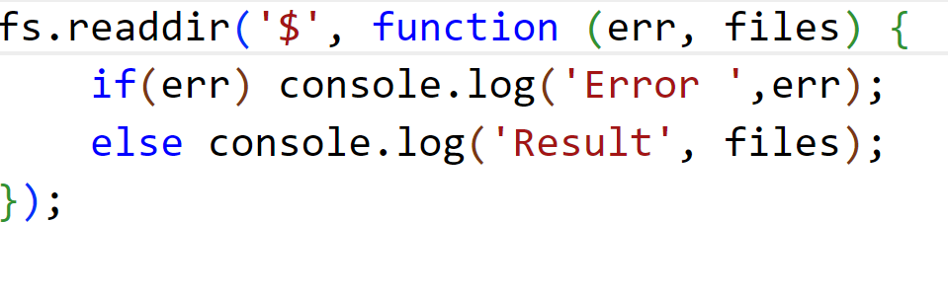
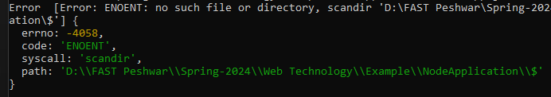
Error in Aysnchronous method calls

Slide 19
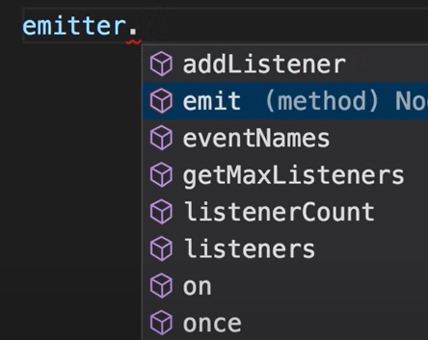
Event in Node
Every action on a computer is an event. Like when a file is opened.
EventEmitter is class. First creat instance of class, i.e., emitter.
EventEmitter class has methods.
Notes:
In Node.js, EventEmitter is a built-in class that allows objects to emit and handle events.
Suppose you're building a chat application where users can send messages to each other.
You might use EventEmitter to handle events such as when a new message is received, when a user joins or leaves a chat room, or when a user is typing a message.

Slide 20
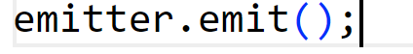
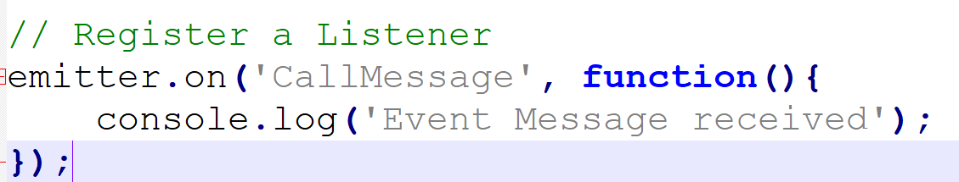
Use emit method of Event Class
To fire an event, use the emit() method. emit() raise an Event.
Emit mean make a noise or produce something - signaling.
Nothing is going to happen. We need to register the event.

Slide 21
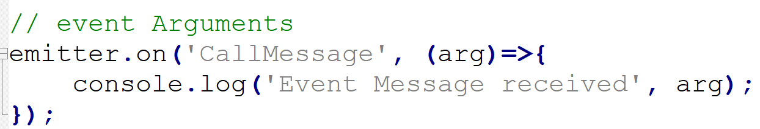
Event Arguments

Slide 22
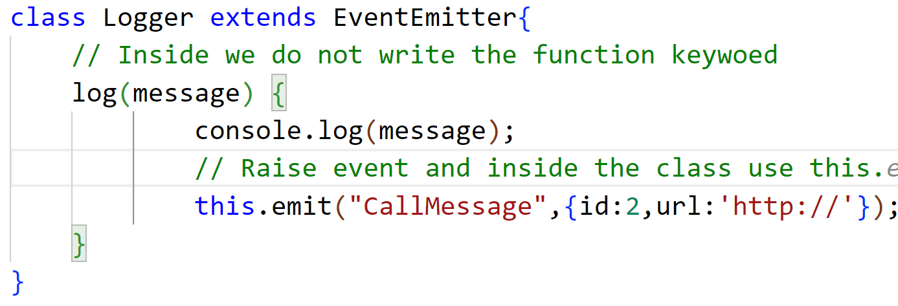
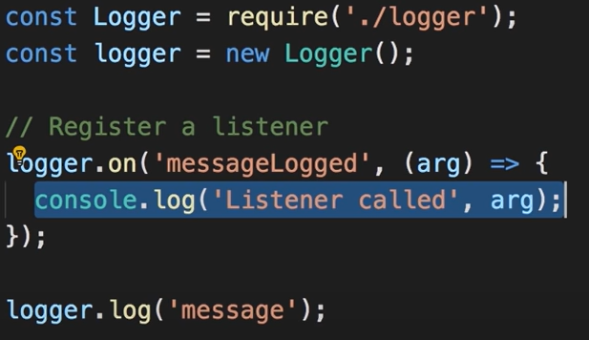
Extending Event
Logger.js file
App.js file

Slide 23
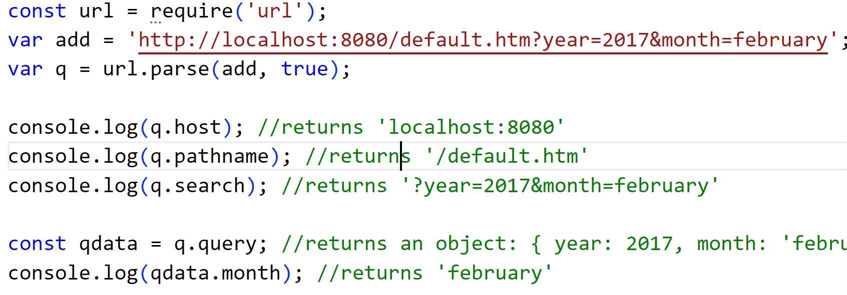
URL Module
The URL module splits up a web address into readable parts.
Parse an address with the url.parse() method, and it will return a URL object.

Slide 24
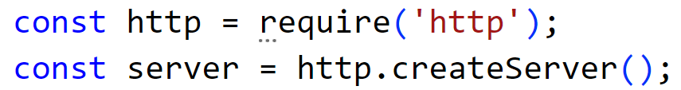
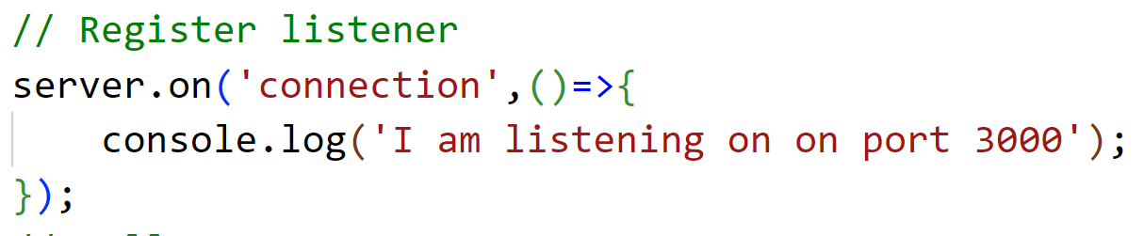
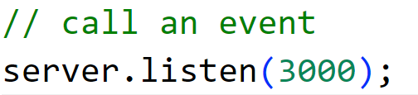
HTTP Module (Creating http server)

Slide 25
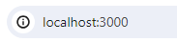
HTTP Module (Creating http server)
The HTTP module can create an HTTP server that listens to server ports and gives a response back to the client.
Use the createServer() method to create an HTTP server.
The function passed into the http.createServer() method, will be executed when someone tries to access the localhost on port 3000.

Slide 26
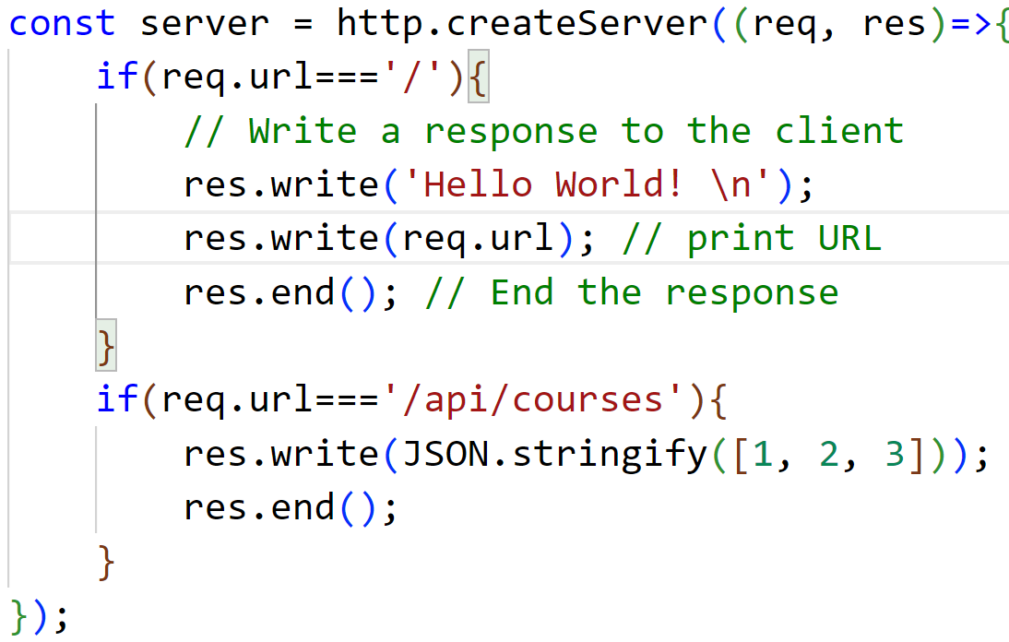
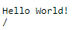
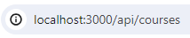
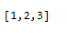
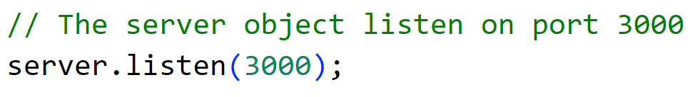
HTTP Server with arguments
Notes:
converts the given JavaScript object or value into a JSON string representation. In this case.
const obj = { name: 'John', age: 30, city: 'New York' };
const jsonString = JSON.stringify(obj, false);
console.log(jsonString);

Slide 27
Express
The above approach is not good for large and complex application.
If we have too many URL, we need to hard code each of them.
Use Express, which is light weight framework

Slide 28
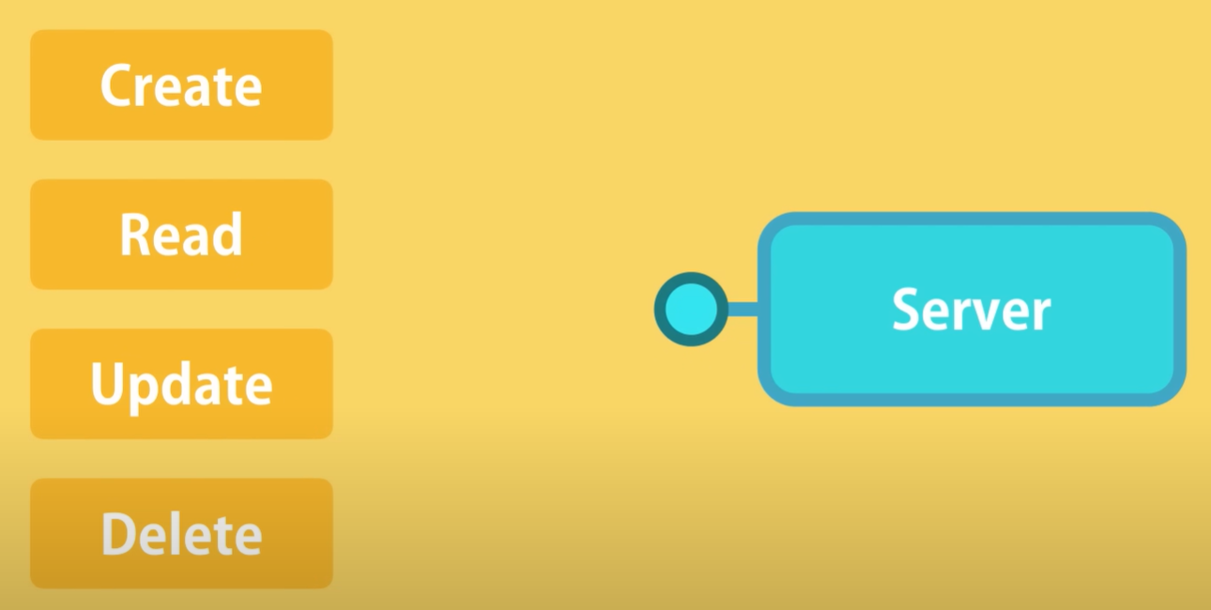
RESTful services or APIs
We create service that provide the following operations.
This operations all togather are refered to CRUD Operations.
Notes:
Representational State Transfer
Introduced by Ph.D

Slide 29
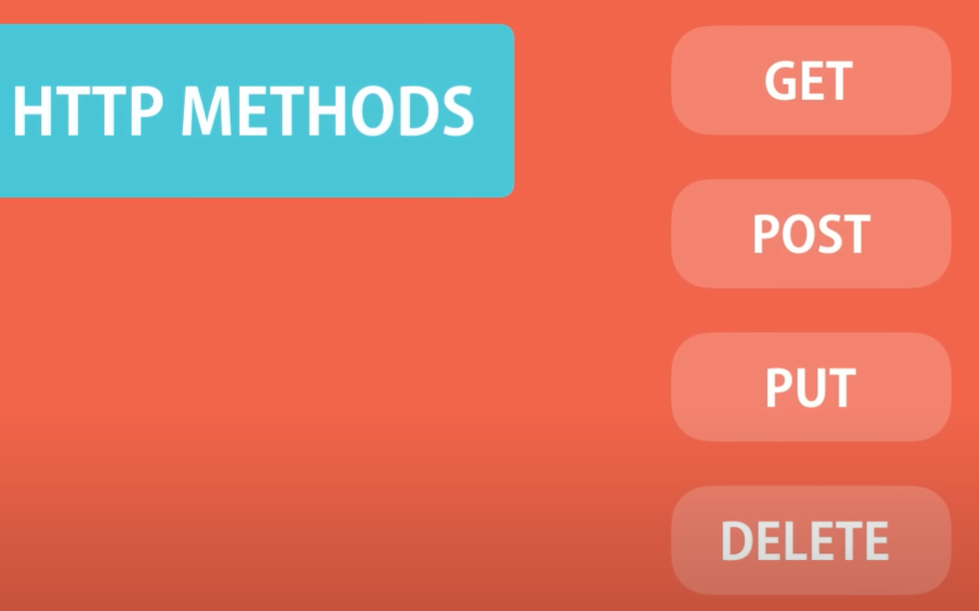
HTTP Methods
GET: for getting data: Requests using GET should only retrieve data and should have no other effec
POST: creating data: The POST method requests that the server accept the data enclosed in the request.
PUT: for updating data: The PUT method requests that the server accept the data enclosed in the request as a modification to existing object identified by the URI
DELETE: for deleting data: DELETE method requests that the server delete the specified resource
Notes:
Representational State Transfer
Introduced by Ph.D

Slide 30
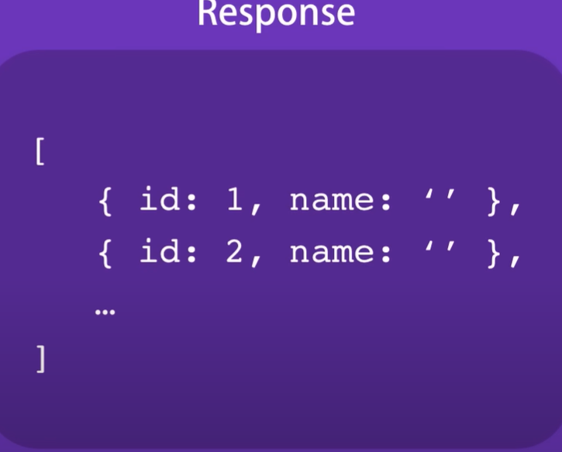
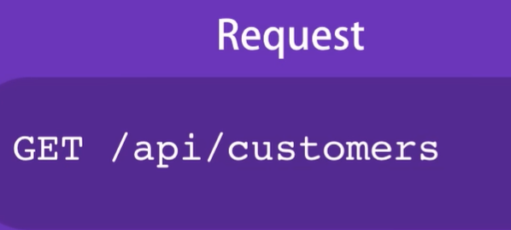
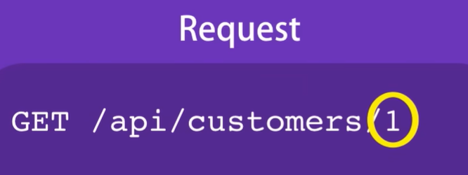
GET Methods Example
Notes:
Representational State Transfer
Introduced by Ph.D

Slide 31
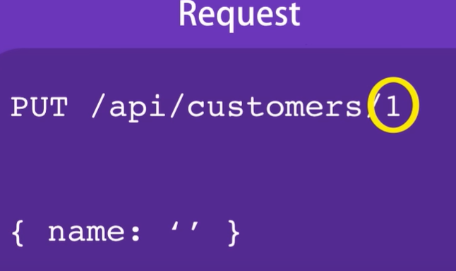


PUT (UPDATE) and DELETE Methods Example
Notes:
Representational State Transfer
Introduced by Ph.D

Slide 32


POST Methods Example
Notes:
Representational State Transfer
Introduced by Ph.D

Slide 33

Introducing Express
ExpressJS is a web application framework.
It provides us with a simple API to build websites, web apps and back ends
Express was developed by TJ Holowaychuk
It is maintained by the Node.js foundation
go to https://www.npmjs.com/
Search express in Search Bar

Slide 34




Express Installation
make a directory and run the command inside directory

Slide 35

Working with Express

Slide 36



First Web Server
Notes:
This function tells what to do when a get request at the given route is called. The callback function has 2 parameters, request(req) and response(res). The request object(req) represents the HTTP request and has properties for the request query strres.send()
This function takes an object as input and it sends this to the requesting clienting, parameters, body, HTTP headers, etc. Similarly, the response object represents the HTTP response that the Express app sends when it receives an HTTP request.

Slide 37



Nodemon
Notes:
-g Install it globally

Slide 38


Evironmental Variable
Port is dynamically assigned by the hosting provider
port number can change every time our application or service restarts or is redeployed.
3000 port may work on local but not on server. We need to set Environment Variable.
Environment variables are variables that are defined in the environment in which the Node.js process is running.
Express.js allows us to access environment variables using the process.env object
Notes:
Environment variables are commonly used to store sensitive information such as database connection strings, API keys, or configuration settings that may vary between different environments (such as development, staging, and production).
This object contains key-value pairs where the keys are the names of the environment variables, and the values are their corresponding values
on window set PORT = 5000;
mac use export

Slide 39

Router Parameters
We can pass parameters to the app.get() route handler using route parameters or query parameters.
Route parameters are part of the URL path and are defined by placing a colon (:) followed by the parameter name in the route path.

Slide 40


Router Parameters
We can pass multiple parameters to the app.get() route handler using route parameters or query parameters

Slide 41


Router Parameters
We can pass query string as parameters to the app.get().
Parameters that are added after question mark (?).

Slide 42

Pattern Matched Routes
We can also use regex to restrict URL parameter matching.
Let us assume we need the id to be a 5-digit long number.
Notes:
In case It does not match then error will be kind of Cannot GET /api/courses/1

Slide 43

Pattern Matched Routes
To display a user defined message, when the Regular Expression does not match or URL route is defined.
Use * in the route.
Important − This should be placed after all your routes, as Express matches routes from start to end of the index.js file.
Notes:
In case It does not match then error will be kind of Cannot GET /api/courses/1

Slide 44


Handling GET Request
Retrieve specific data using app.get().

Slide 45



Handling POST Request
Json() is a middleware function designed to handle the data inside the body of a POST request.
Middleware functions have access to the request object (req), the response object (res)
Notes:
app.use(express.json()); adds middleware to your Express application to handle JSON-encoded request bodies
The app.use() method is used to mount middleware functions in the Express application's middleware stack.
Middleware functions are functions that have access to the request object (req), the response object (res), and the next middleware function in the application's request-response cycle.
Middleware functions can perform tasks such as logging, authentication, parsing request bodies, etc.
app.use() is used for middleware functions that should be executed for every incoming request, regardless of the request method or path.

Slide 46




Input Validation

Slide 47





Handling PUT Request

Slide 48




Handling DELETE Request

Slide 49


Routers
Defining routes in single file is very tedious to maintain.
To separate the routes from our main index.js file, we use Express.Router().
Create a new file called things.js.
Then use in index.js
Notes:
Routers help in modularizing and organizing your application's routes and middleware. This becomes especially useful as your application grows in complexity. Instead of defining all routes in a single file, you can split them into multiple router modules based on functionality or resource types.
Routers are very helpful in separating concerns and keep relevant portions of our code together. They help in building maintainable code

Slide 50


Asynchronous JavaScript Demo
Notes:
As We know in real world application we use database instead of an array.
So before going ind detail to access database in node. Make sure we have good and dept understand of Ayschronous

Slide 51


Asynchronous JavaScript Demo

Slide 52

Asynchronous JavaScript Demo

Slide 53
Any Question

